Slide 1
Design Problems
Day 3, Jyvaskyla Summer School 2021 COM3
Michael Emmerich

Slide 2
Learning Goals
Platon’s dream: What are ideal solutions to design problems?
Design as a discipline

Slide 3
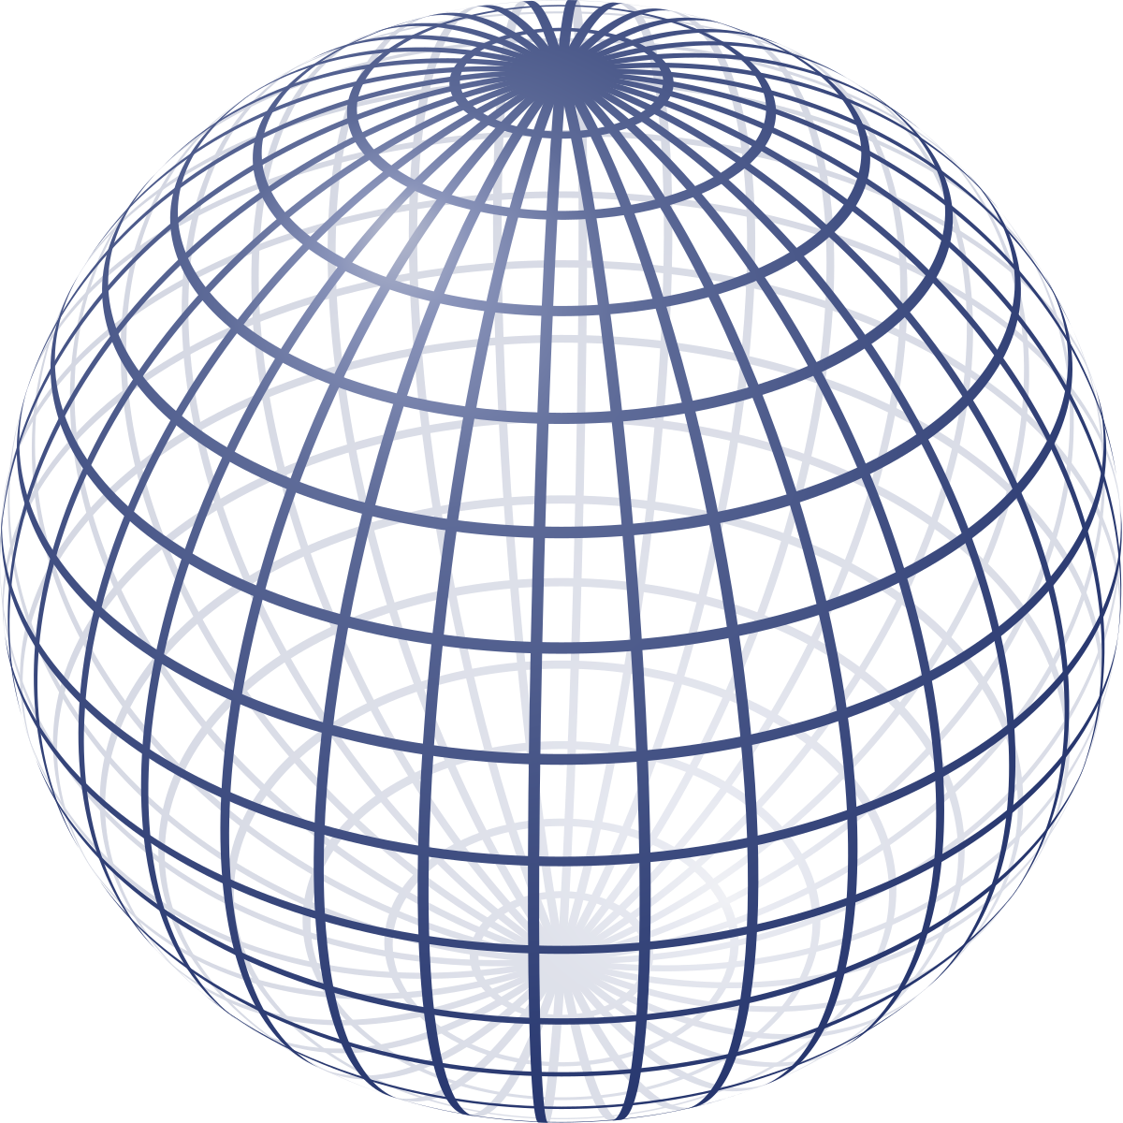
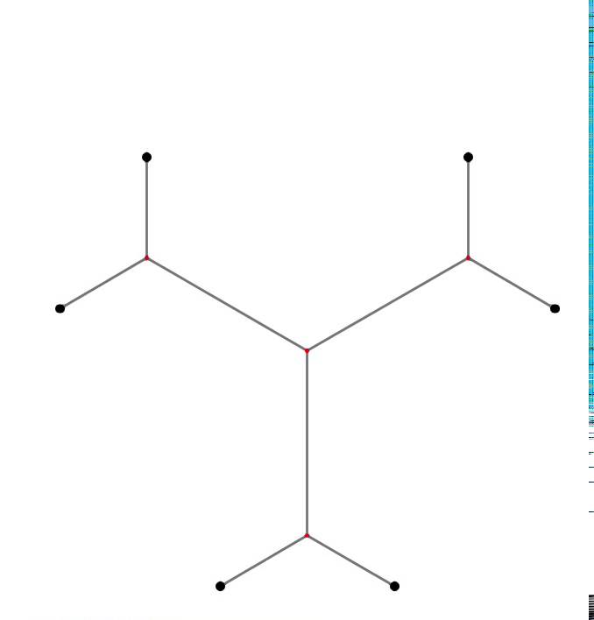
Perfect Structures
Given points
Connect with min path
(Steiner tree)
Min Surface, Volume = const

Slide 4
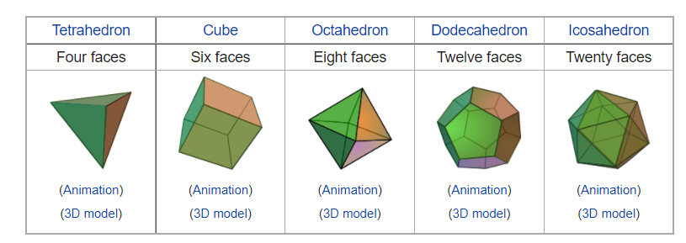
Platonic bodies
Shapes of maximally even (equal) surfaces at their boundary

Slide 5
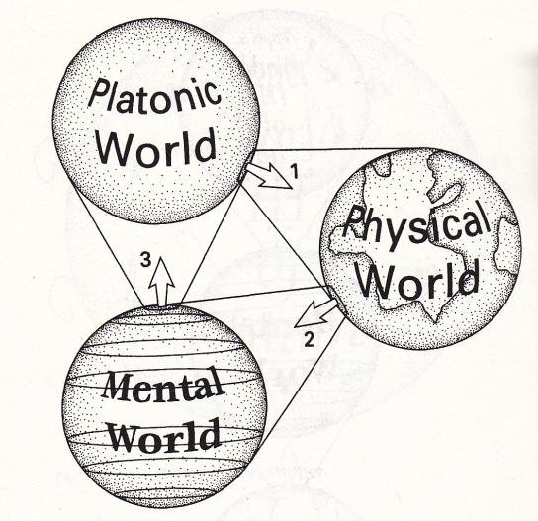
Penrose: Three worlds

Slide 6
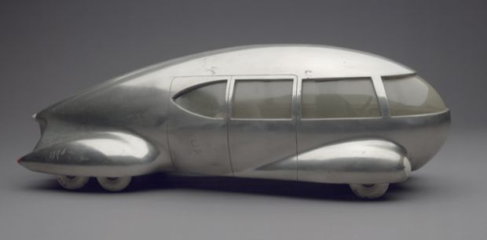
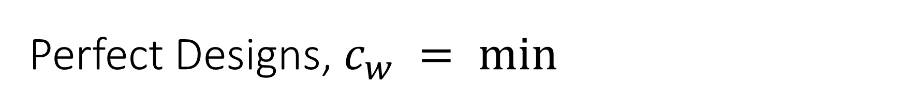
Perfect Designs, $c_{w} = min$
Norman Bel Geddes, "Motor Car No. 9 (without tail fin)"

Slide 7
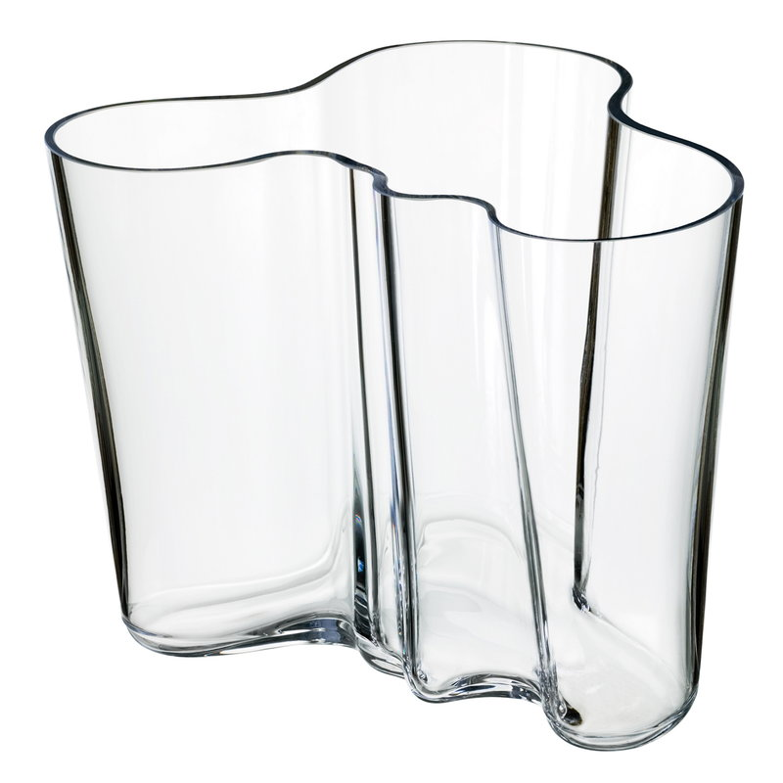
Aalto shape (beauty is hard to measure …)
Think of examples of beautiful shapes in nature …

Slide 8
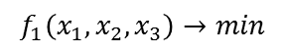
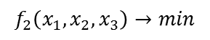
Pareto optimality
$$f_{2}\left(x_{1},x_{2},x_{3}\right)→min$$
Pareto front =
Set of interesting solutions
x2
Image
under f = all possible solutions
f
Search space
(decision space)
Objective space
(solution space)
x1
x3
$$f_{1}\left(x_{1},x_{2},x_{3}\right)→min$$

Slide 9
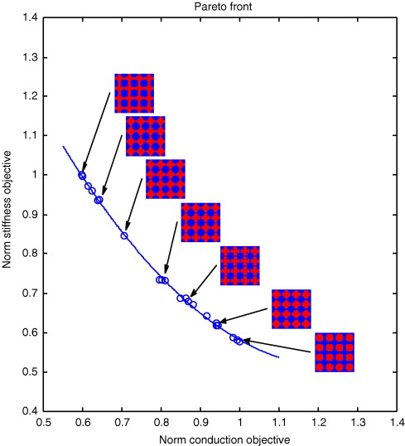
Research questions
Find ‘Pareto perfect’ structures:
Micro-
Macro-
Efficiency
Precision & Coverage
Niek de Kruijf, Shiwei Zhou, Qing Li, Yiu-Wing Mai,Topological design of structures and composite materials with multiobjectives,
International Journal of Solids and Structures, Volume 44, Issues 22-23, 2007, Pages 7092-7109

Slide 10
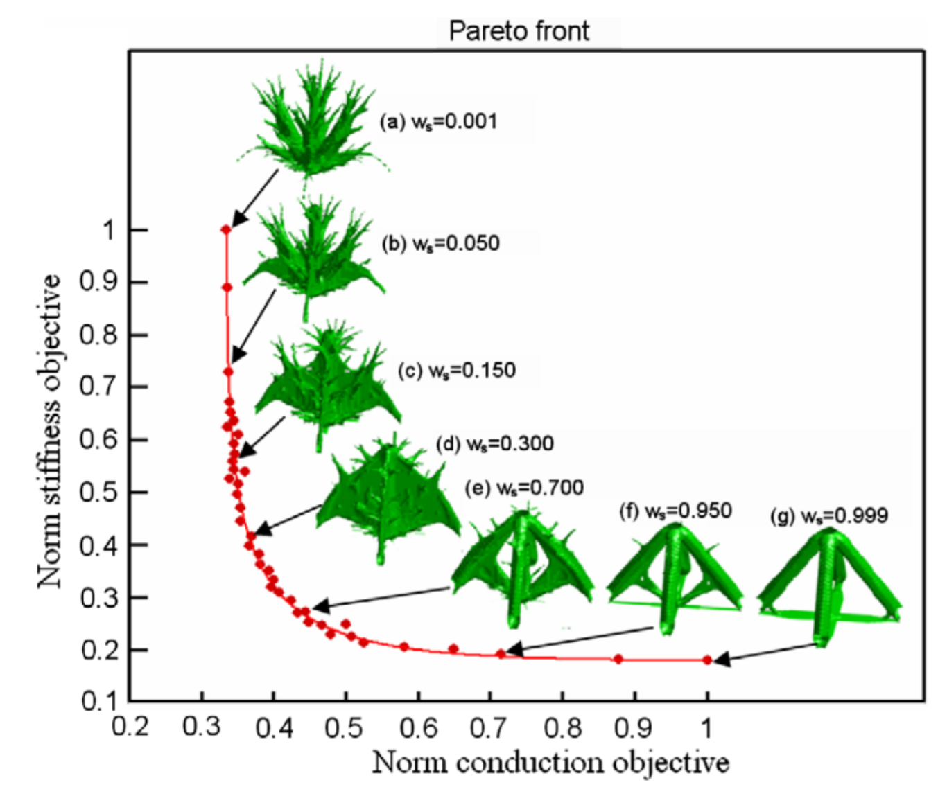
‘Pareto morphing’ along the Pareto front
Chen, Yuhang, Shiwei Zhou, and Qing Li. "Multiobjective topology optimization for finite periodic structures." Computers & Structures 88.11-12 (2010): 806-811.

Slide 11
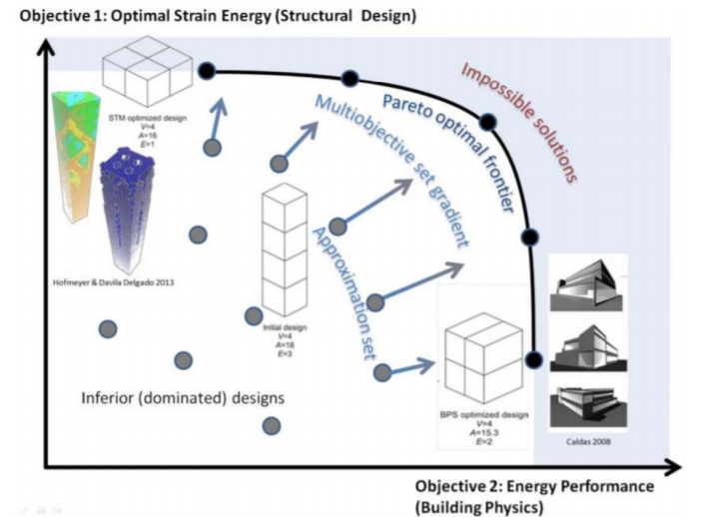

Slide 12
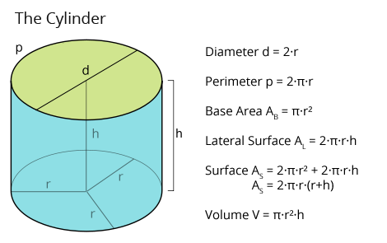
Question
How can we express shapes by means of decision variables?
How can we make sure that constraints are kept?
Example: Cylinder (tin)
Volume → max
Surface → min
Parameters: r, h
Constraints: r > 0, h > 0

Slide 13
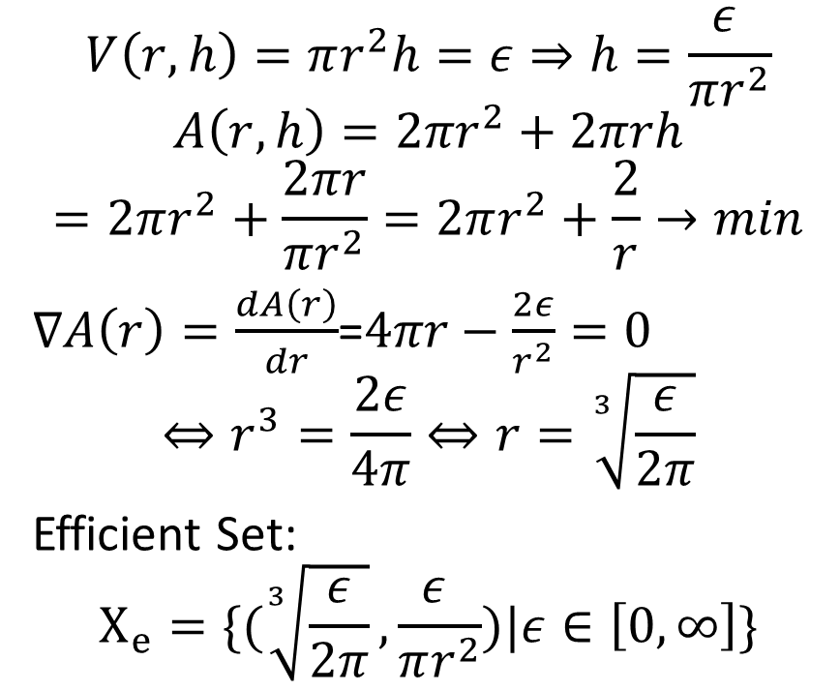
Solution
$$V\left(r,h\right)=πr^{2}h=ε⇒h=\frac{ε }{πr^{2}}$$
$$A\left(r,h\right)={2πr}^{2}+2πrh$$
$$=2πr^{2}+\frac{2πr}{πr^{2}}=2πr^{2}+\frac{2}{r}→min$$
$∇A\left(r\right)=\frac{dA\left(r\right)}{dr}$=$4πr−\frac{2ε}{r^{2}}=0$
$$⇔r^{3}=\frac{2ε}{4π}⇔r=\sqrt[3]{\frac{ε}{2π}}$$
Efficient Set:
$$X_{e}=\{(\sqrt[3]{\frac{ε}{2π}},\frac{ε }{πr^{2}})|ε∈\left[0, ∞\right]\}$$

Slide 14
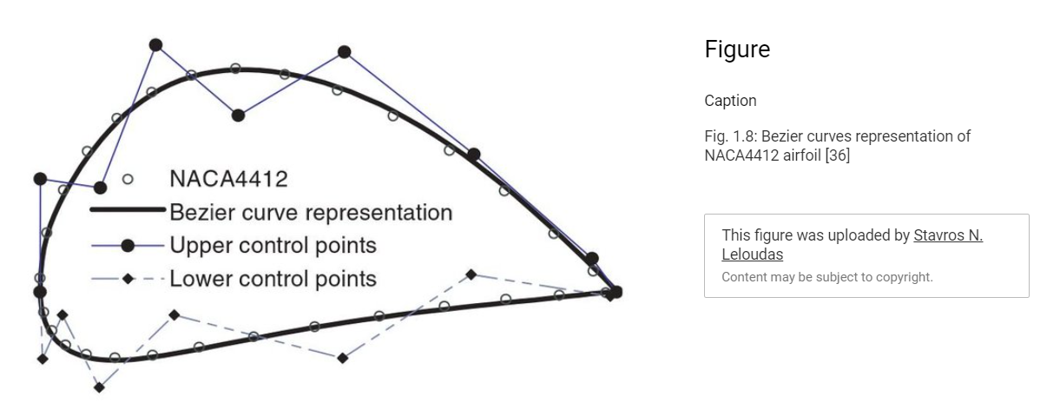
Design Parameterization
Design Parameterization is the problem of describing a geometrical shape by means of continuous parameter vectors
Examples: Bezier points, superstructures

Slide 15
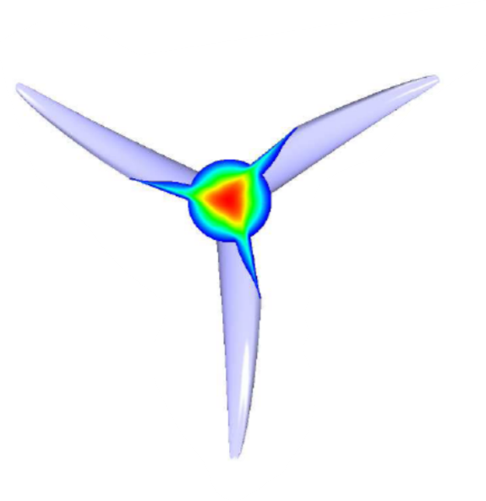
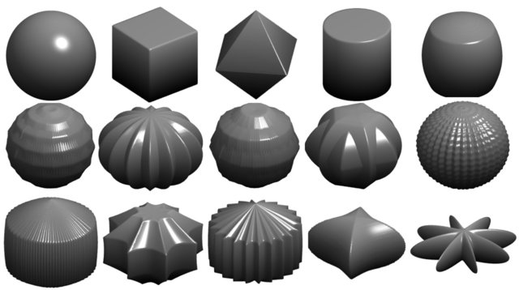
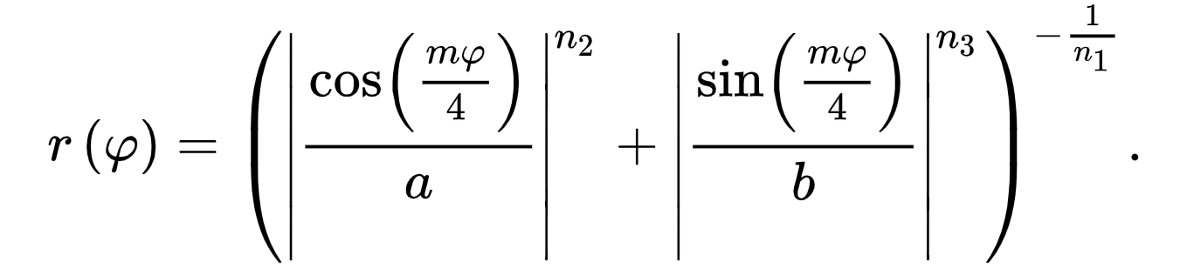





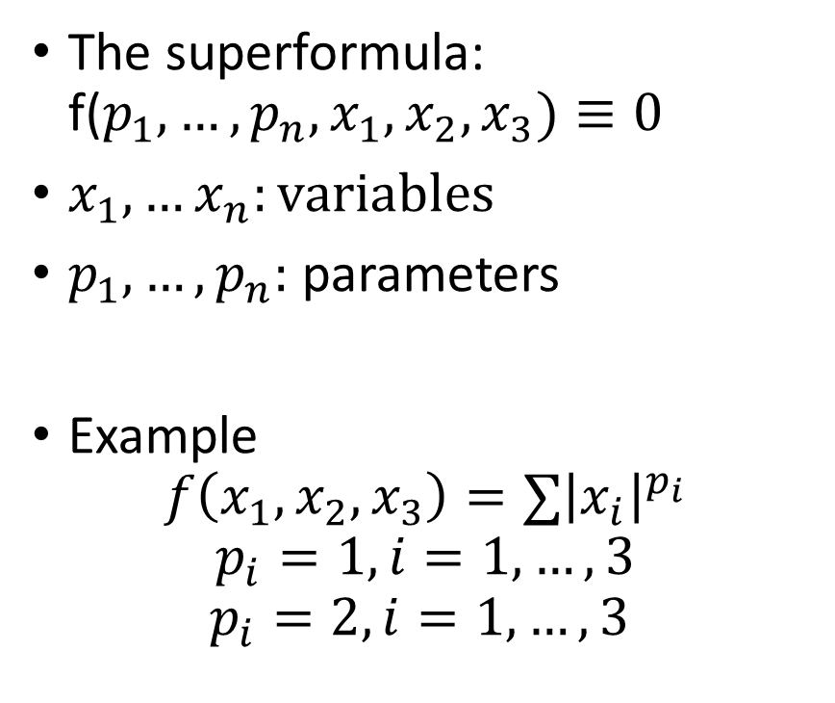

Gielis’ superformula
https://arxiv.org/pdf/1204.4107.pdf
The superformula: f($p_{1},…, p_{n},x_{1},x_{2},x_{3})≡0$
$x_{1},…x_{n}:variables$
$p_{1}, …, p_{n}:$ parameters
Example
$$f\left(x_{1},x_{2},x_{3}\right)=∑{\left|x_{i}\right|}^{p_{i}}$$
$$p_{i}=1, i=1,…,3$$
$$p_{i}=2,i=1,…,3$$

Slide 16
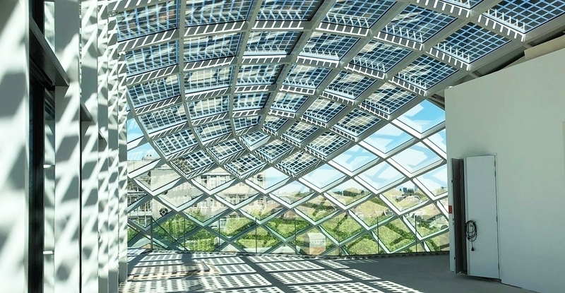
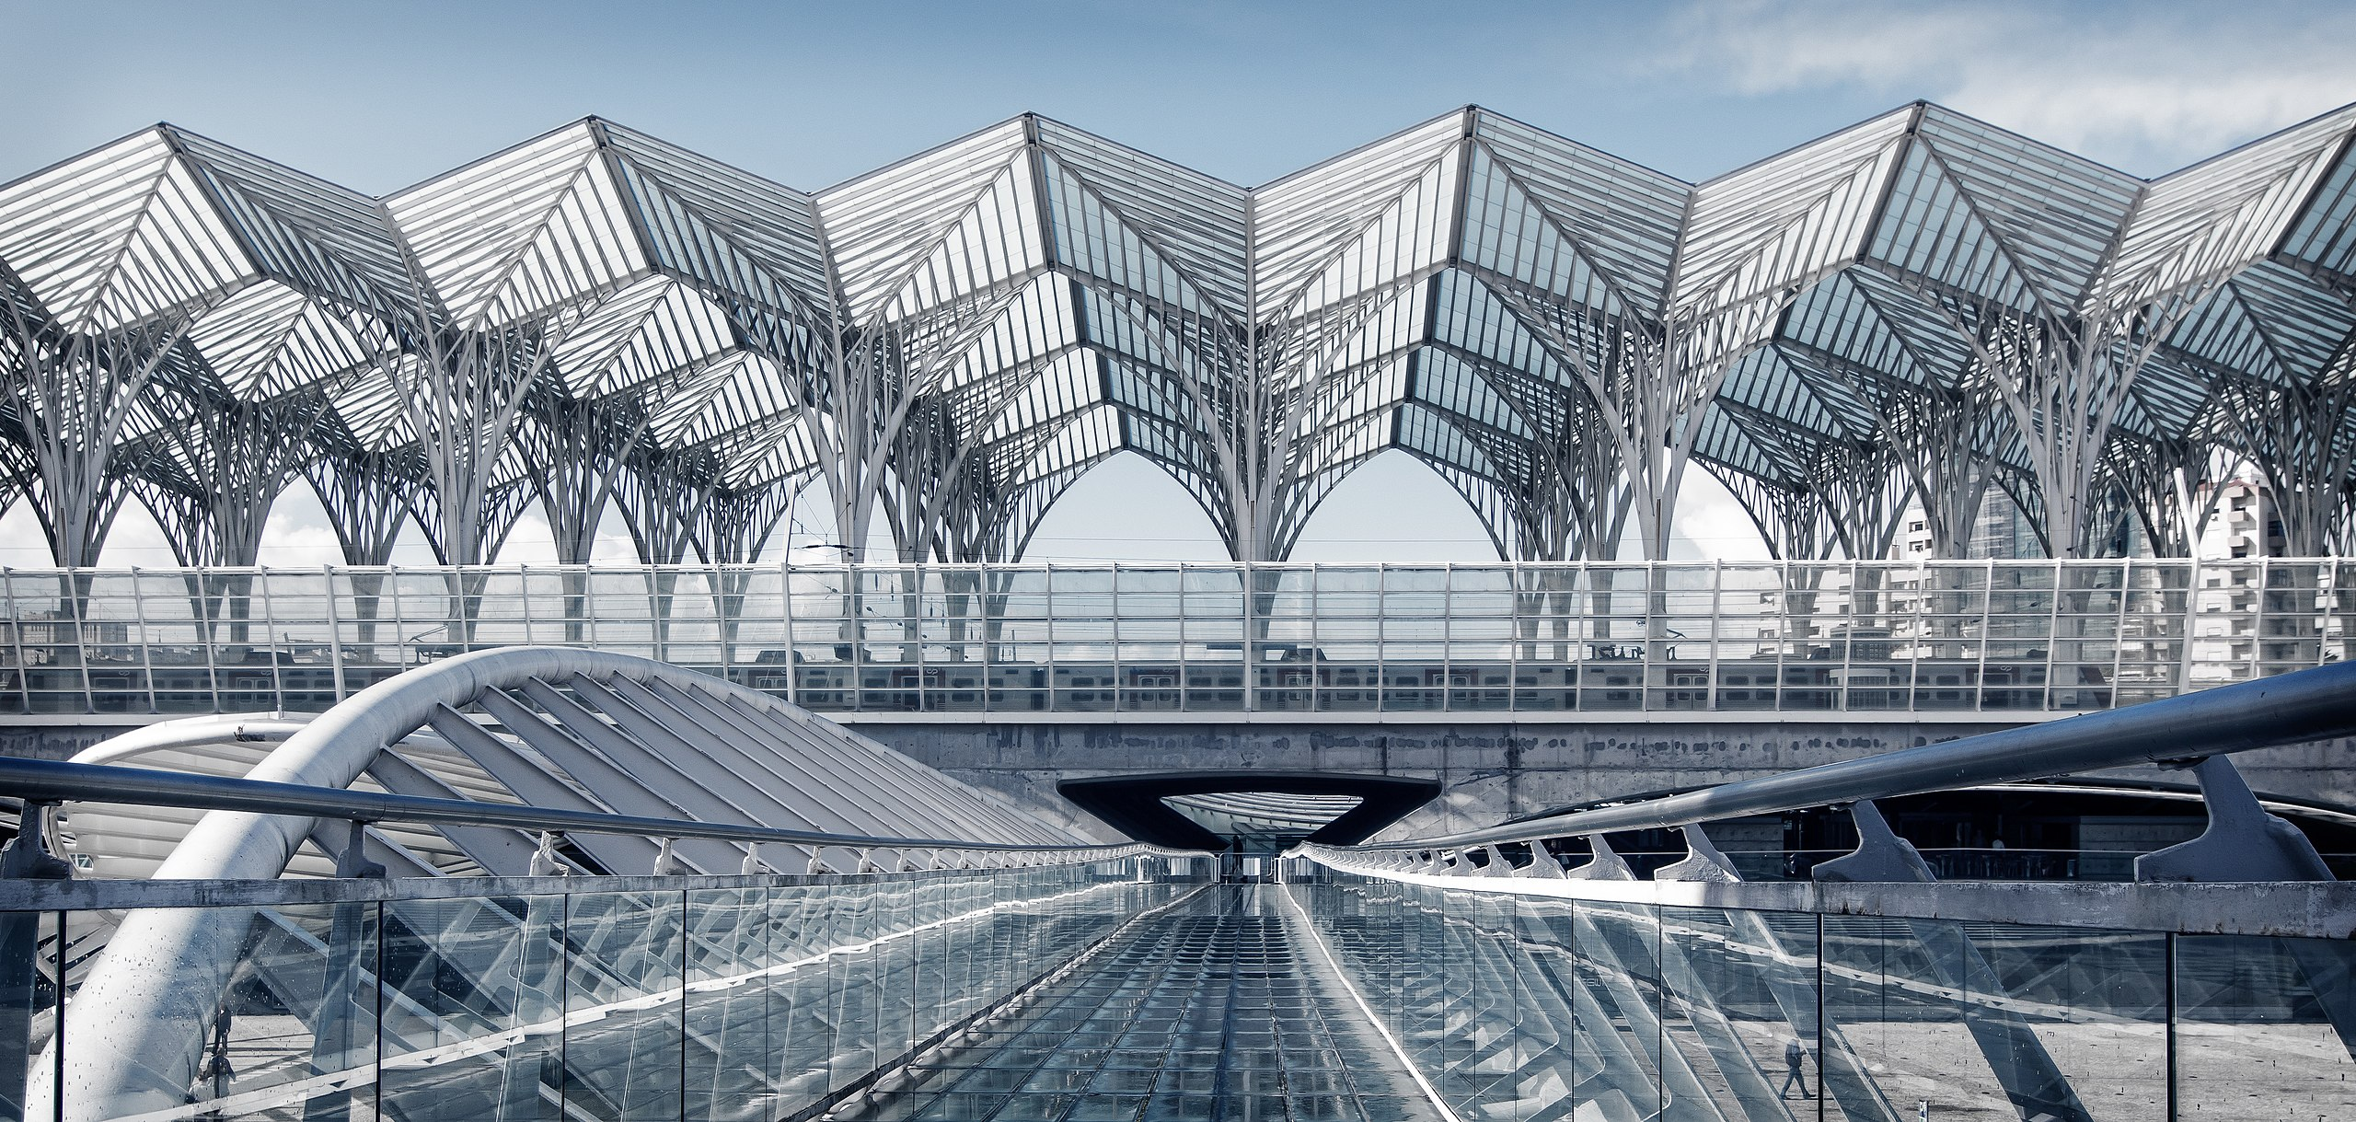
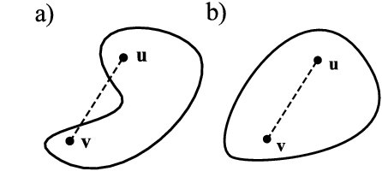
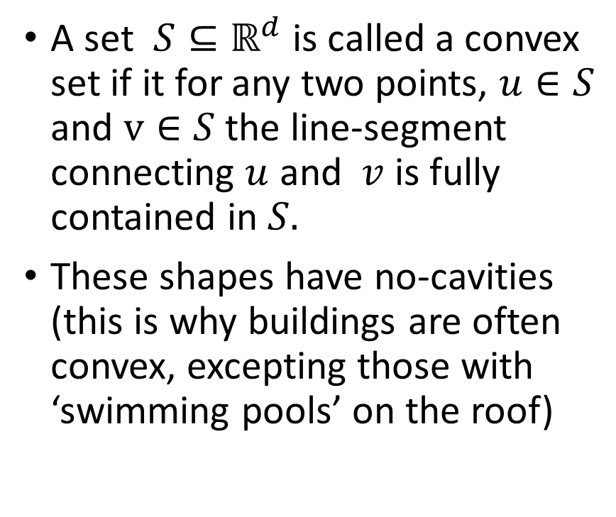
Convexity
A set ${S⊆\text{ℝ}}^{d}$ is called a convex set if it for any two points, $u∈S$ and $v∈S$ the line-segment connecting $u$ and $v$ is fully contained in $S.$
These shapes have no-cavities (this is why buildings are often convex, excepting those with ‘swimming pools’ on the roof)
Idea
Represent buildings as
convex shapes

Slide 17
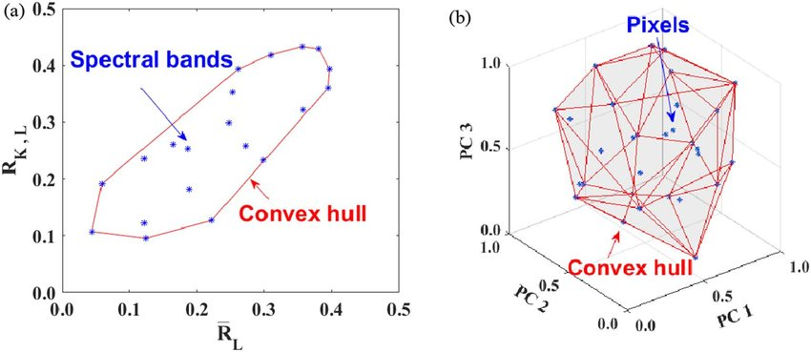
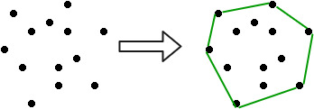
Convex hull representation
The convex hull is the smallest convex set that contains all points
In 2-D you can imagine a rubber-band around the set
Convex hulls can be used to represent the set of all convex shapes by means of point sets
‘Active’ points form corners of this sets. Inactive points are redundant and can be removed.

Slide 18
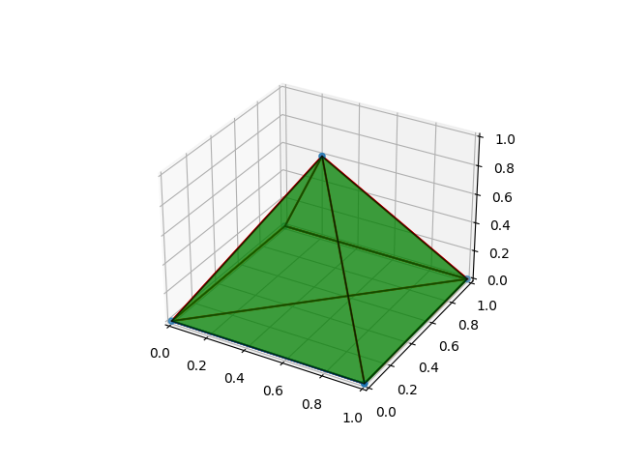
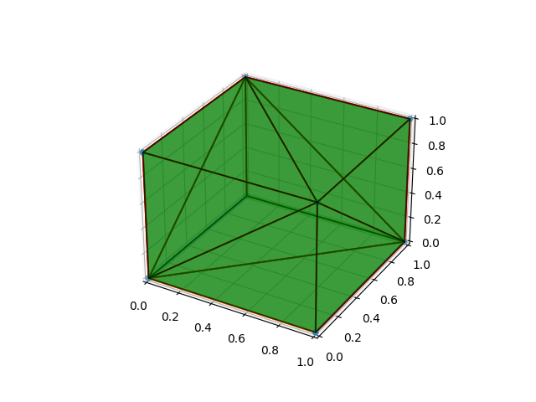
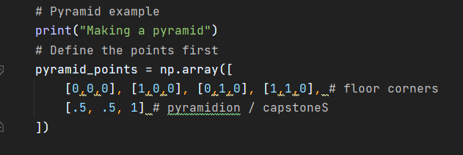
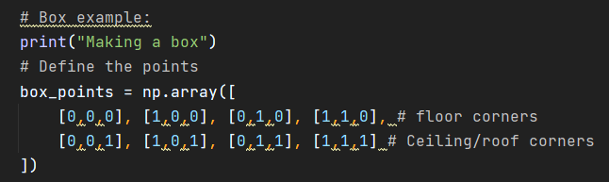
Design optimization – 3D Shapes

Slide 19
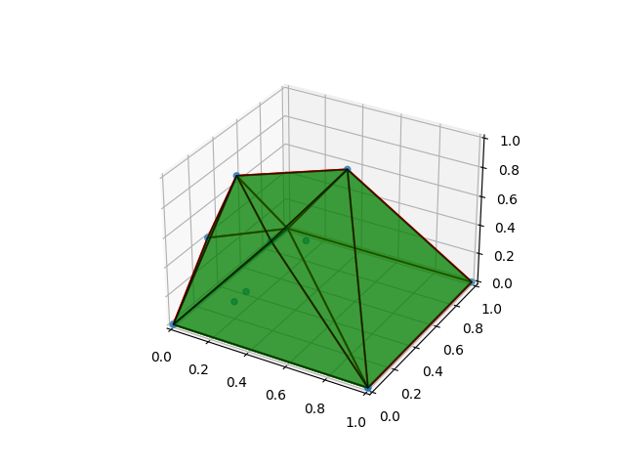
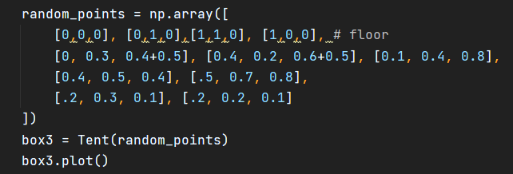
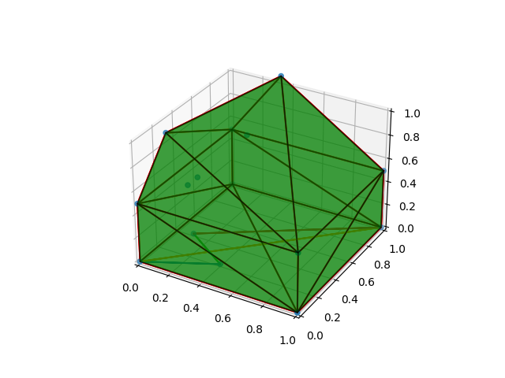
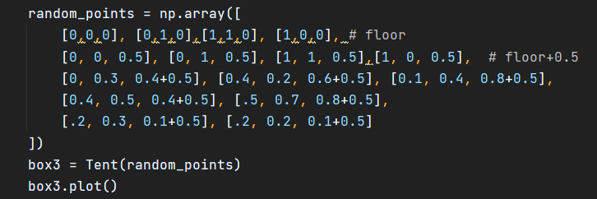
Walls, floors, and roofs

Slide 20
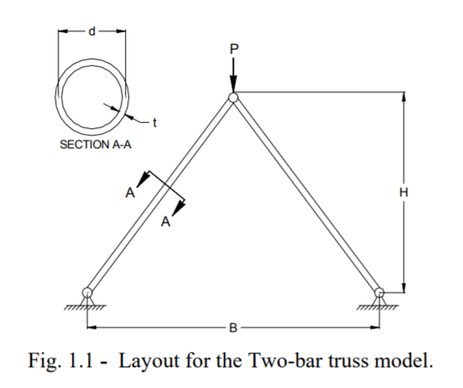
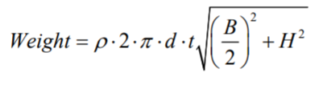
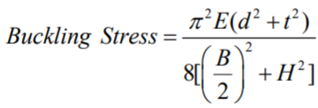
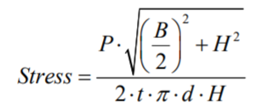
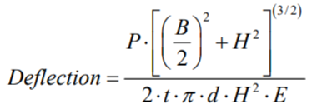
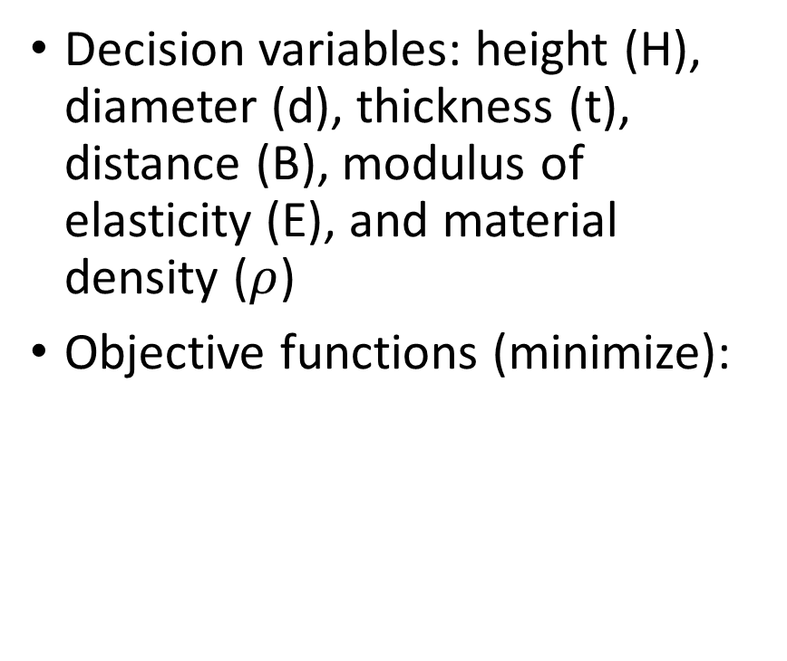
Two bar truss problem
Decision variables: height (H), diameter (d), thickness (t), distance (B), modulus of elasticity (E), and material density ($ρ$)
Objective functions (minimize):

Slide 21
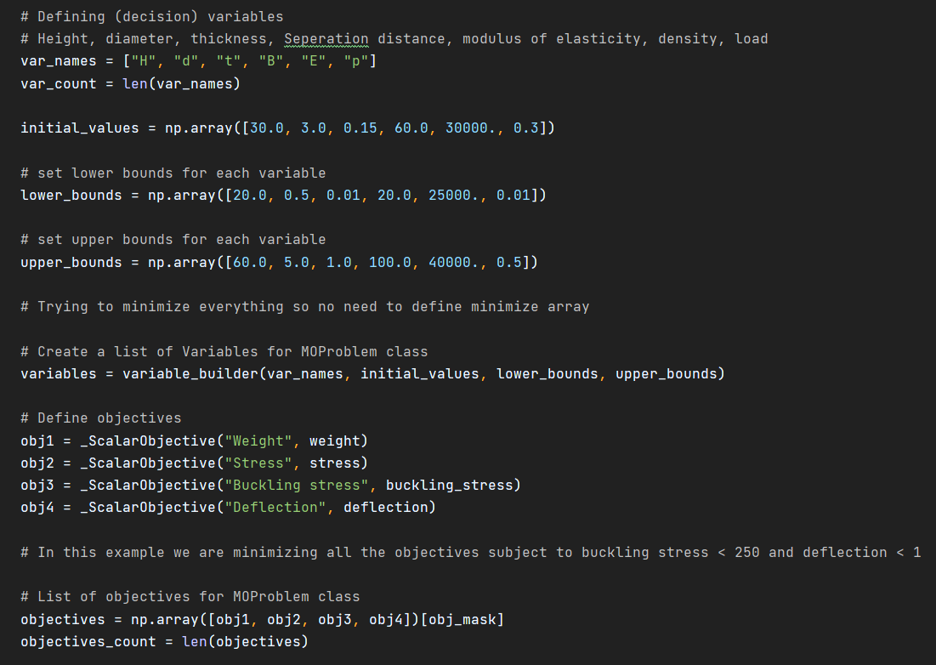
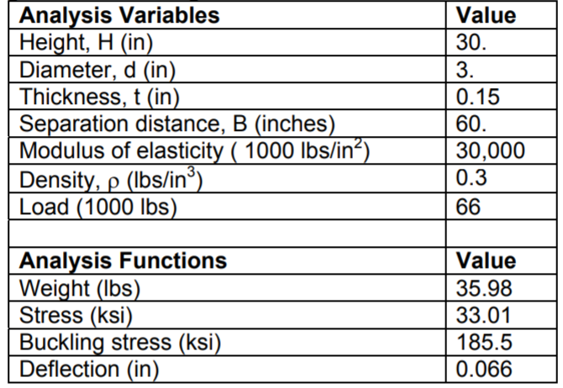
More data (example point)

Slide 22
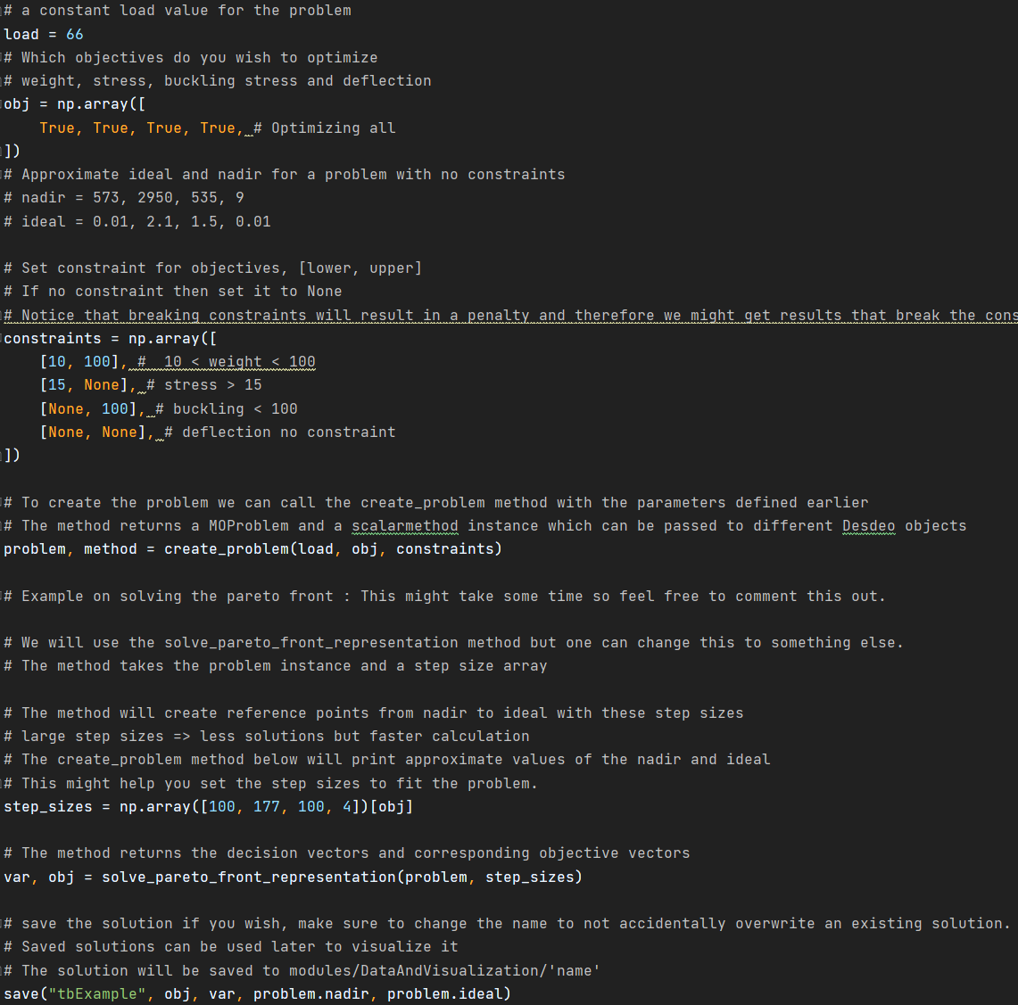
The python examples …
The problem needs to put constraints on the objectives that are not used in the Pareto optimization
We have additionally created a script that allows to visualize the Pareto front
PySummerschool\modules\TwoBarTruss\problem.py
PySummerschool\createTwoBartrussProblem.py
PySummerschool\visualizeTwoBarTruss.py

Slide 23
To be continued …

